Slide 1
Time-Series Anomaly Detection Service at Microsoft
Author : Hansheng Ren, Bixiong Xu

Slide 2
INTRODUCTION
In this paper, we focus on the algorithm of our anomaly detection service specialized for time-series data, which is designed to be accurate, efficient and general.
They propose a novel algorithm based on Spectral Residual (SR) and Convolutional Neural Network (CNN), and work the first attempt to borrow the SR model from visual saliency detection domain to time-series anomaly detection. we innovatively combine SR and CNN together to improve the performance of SR model.

Slide 3
Three of challenges in designing an industrial service for time-series anomaly detection
Challenge 1: Lack of Labels
To provide anomaly detection services for a single business scenario, the system must process millions of time-series simultaneously. There is no easy way for users to label each time-series manually
Challenge 2: Generalization
Various kinds of time-series from different business scenarios are required to be monitored. However, existing approaches are not generalized enough for different patterns.
Challenge 3: Efficiency
In business applications, a monitoring system must process millions, even billions of time-series in near real time. Especially for minute-level time-series, the anomaly detection procedure needs to be finished within limited time.

Slide 4
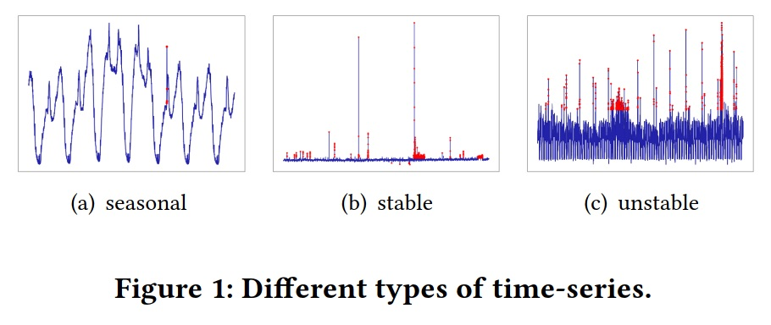
時間序列的形式

Slide 5
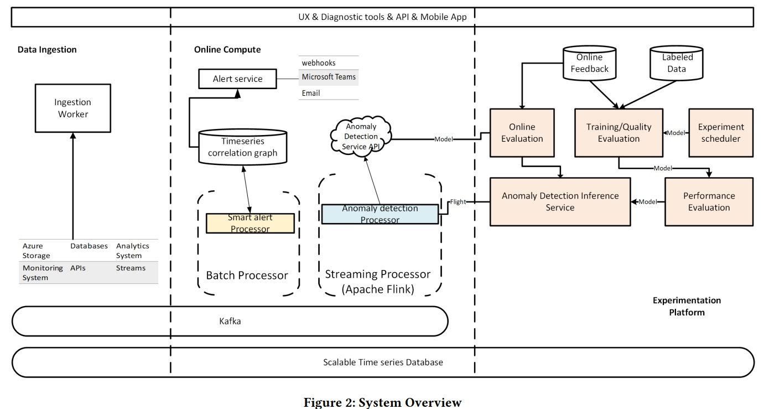
System overview

Slide 6
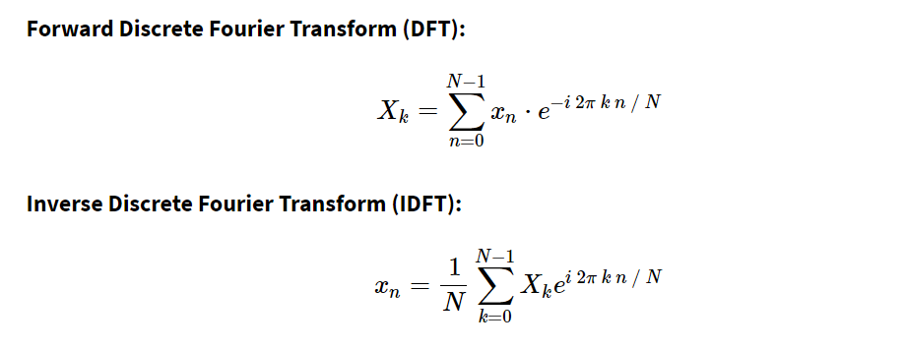
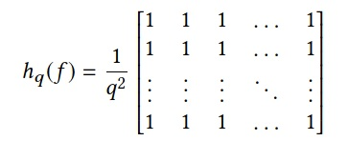
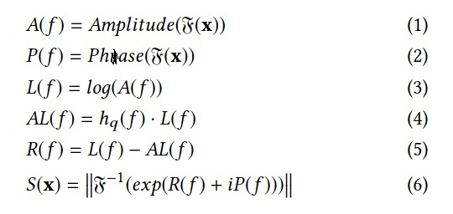
SR (Spectral Residual) algorithm
第一步驟 使用傅立葉轉換，取得對數的振幅頻譜，也就是每個頻率的幅度。
第二步驟 計算這些公式
第三步驟 用反傅立葉轉換，將序列轉換為空間域

Slide 7
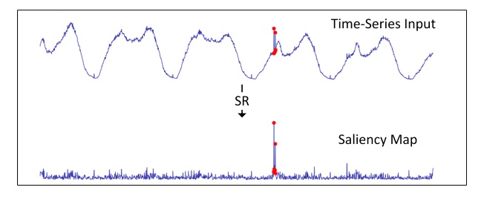
SR的圖像化

Slide 8
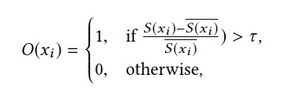
序列O(xi)

Slide 9
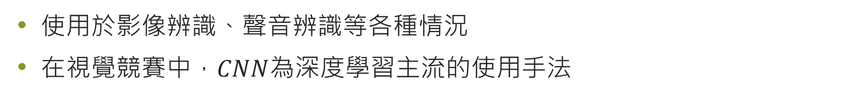
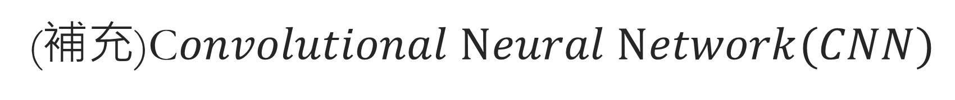

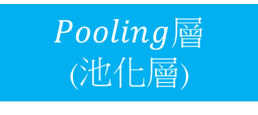
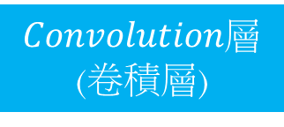
(補充)C$onvolutional Neural Network(CNN)$
使用於影像辨識、聲音辨識等各種情況
在視覺競賽中，$CNN$為深度學習主流的使用手法
$Convolution$層
(卷積層)
$Pooling$層
(池化層)
神經網路結構
$CNN$結構

Slide 10

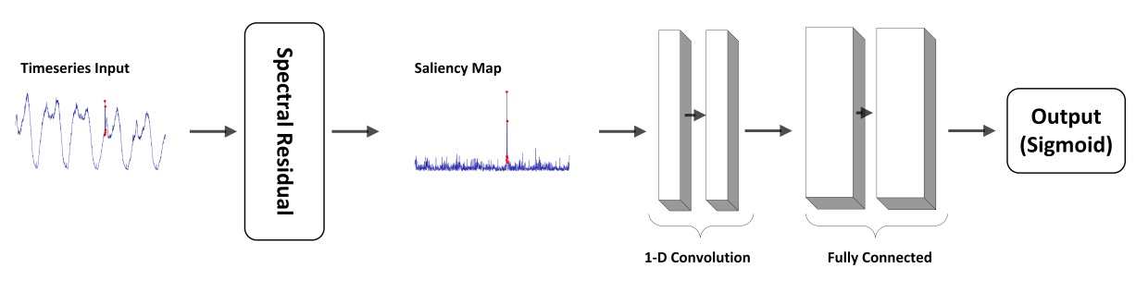
SR+CNN
標籤依靠這個公式模擬產生

Slide 11
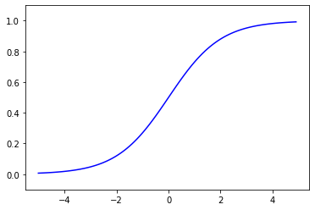
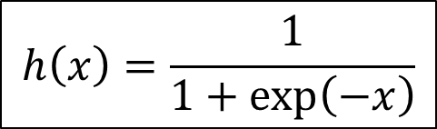
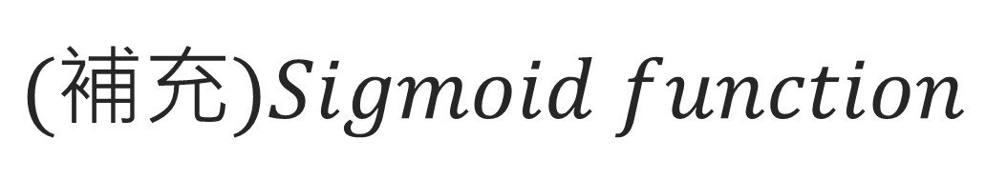
$$(補充)Sigmoid function$$
$$h\left(x\right)=\frac{1}{1+\exp\left(−x\right)}$$

Slide 12
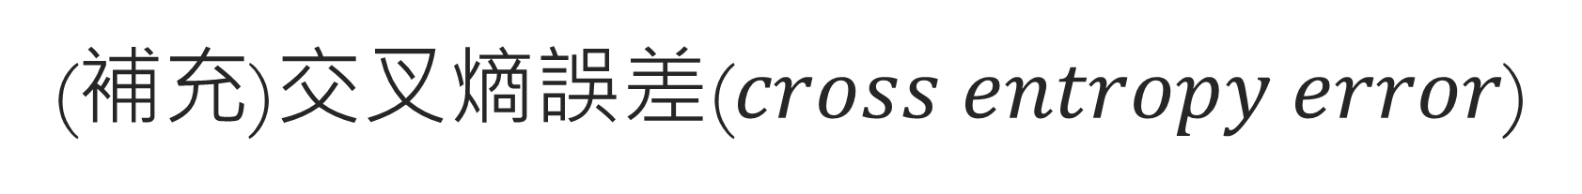
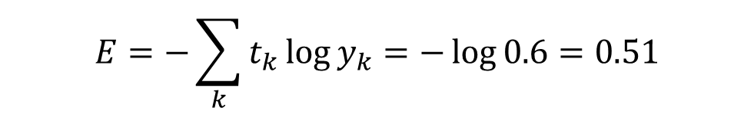
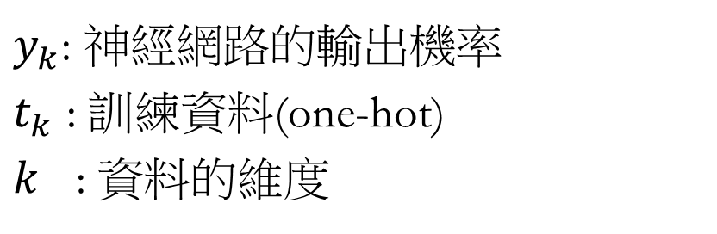
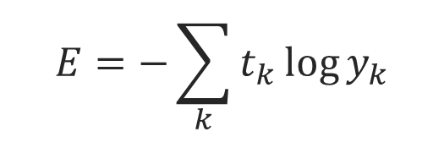
(補充)交叉熵誤差($cross entropy error$)
$$E=−\sum_{k}{t_{k}\log{y_{k}}}$$
$y_{k}$: 神經網路的輸出機率
$t_{k}$ : 訓練資料(one-hot)
$k$ : 資料的維度
標籤
輸出(機率)
$$E=−\sum_{k}{t_{k}\log{y_{k}}}=−\log{0.6}=0.51$$

Slide 13
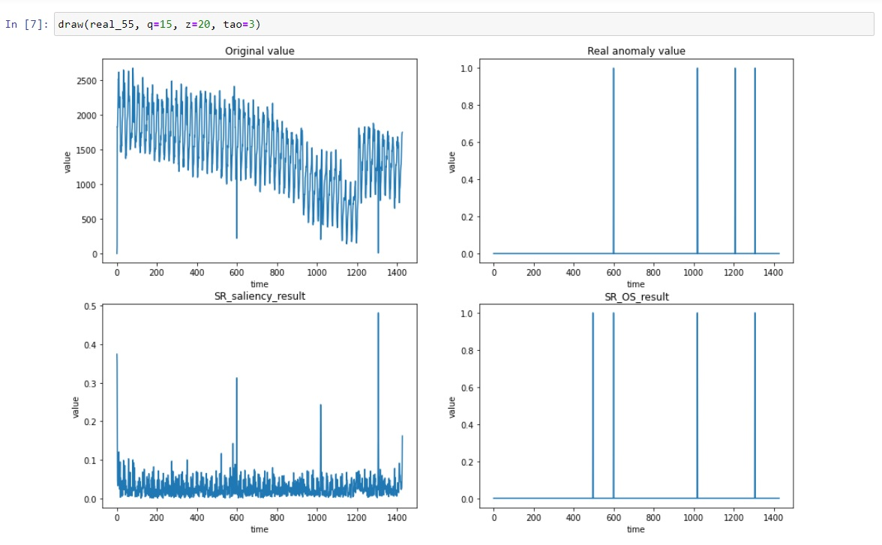
Result-real data

Slide 14
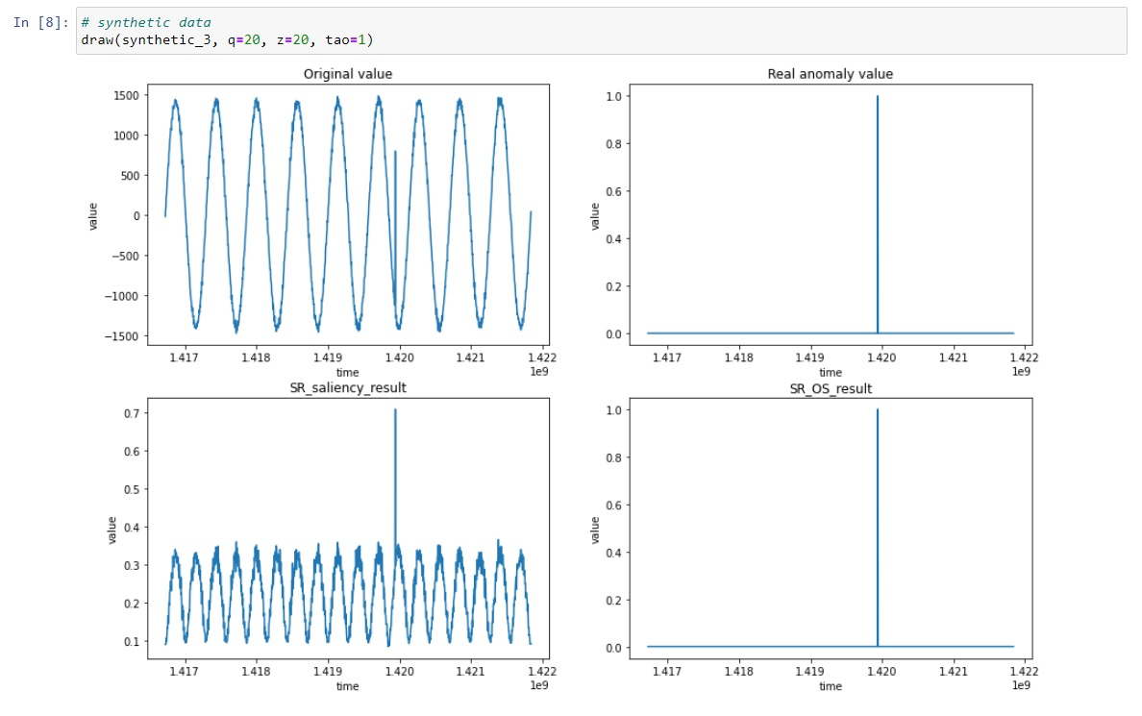
Result-synthetic data

Slide 15
Conclusion & Future work
該論文介紹的時間序列異常檢測方法，在微軟內部已經被廣泛使用，且生產中每分鐘最多可以檢測到400萬個時間序列中的異常情況，這代表論文提出的SR(光譜殘差)+CNN(卷積神經網路)是一個創新且可行的檢測方法。
作者希望除了微軟內部能使用外，不久的將來能在Microsoft Azure上向他們的客戶推廣這項新穎的時間序列異常檢測服務，提供客戶一個新的選擇。
(註) Microsoft Azure 雲端平台提供專為協助您實現新解決方案而設計的 200 多項產品和雲端服務，以解決現今的挑戰並創造未來。使用自選工具與架構，在多個雲端、內部部署和邊緣建置、執行及管理應用程式。

Slide 16
參考資料
Time-Series Anomaly Detection Service at Microsoft
Deep Learning 用Python進行深度學習的基礎理論實作
https://github.com/simon108018/Machine-Learning/blob/master/meeting/Deep%20Learning%20%E7%94%A8Python%E9%80%B2%E8%A1%8C%E6%B7%B1%E5%BA%A6%E5%AD%B8%E7%BF%92%E7%9A%84%E5%9F%BA%E7%A4%8E%E7%90%86%E8%AB%96%E5%AF%A6%E4%BD%9C/Ch4.pptx
https://github.com/simon108018/Machine-Learning/blob/master/meeting/Deep%20Learning%20%E7%94%A8Python%E9%80%B2%E8%A1%8C%E6%B7%B1%E5%BA%A6%E5%AD%B8%E7%BF%92%E7%9A%84%E5%9F%BA%E7%A4%8E%E7%90%86%E8%AB%96%E5%AF%A6%E4%BD%9C/Ch7.pptx
https://www.miniasp.com/microsoft_azure.html#:~:text=Azure%20%E6%98%AF%E9%96%8B%E6%94%BE%E4%B8%94%E5%BD%88%E6%80%A7,%E7%9A%84IT%20%E7%92%B0%E5%A2%83%E9%80%B2%E8%A1%8C%E6%95%B4%E5%90%88%E3%80%82&text=Azure%20%E6%8F%90%E4%BE%9B%E5%85%A7%E5%BB%BA%E8%BB%9F%E9%AB%94,%E5%B9%B3%E8%A1%A1%EF%BC%8C%E4%BB%A5%E5%8F%8A%E9%AB%98%E5%8F%AF%E7%94%A8%E6%80%A7%E5%8A%9F%E8%83%BD%E3%80%82

